Slide 1
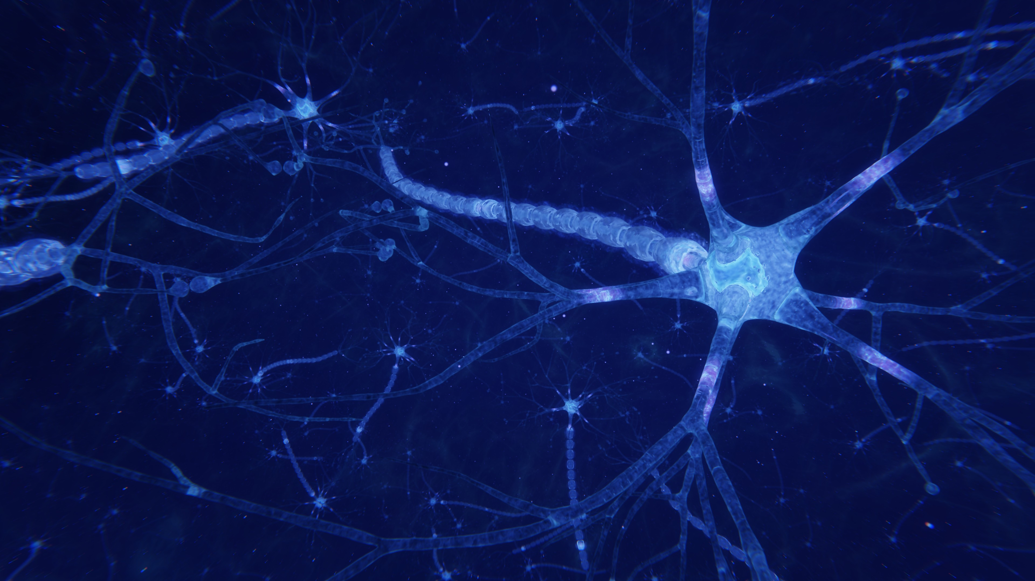

Centre for Computational Personalised Medicine International Research Foundation We create computational technologies for optimised healthcare
CITIZEN BEFORE PATIENT (Cb4P)
“Empowering Personal Health decision making within actionable insights of a Computational Intelligence Architecture of Choice”
Personal Health Data Science Group
7th June, 2022

Slide 2

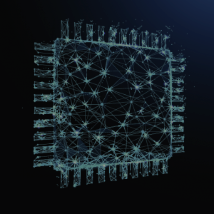




Objectives & Areas
Modelling
and
Simulation
Extreme- scale Computing
Gain new medical knowledge through use of computing
Identify, research and develop Computational Medicine techniques
Combine academic, industry and clinical perspectives
Install training programmes to provide the next generation of healthcare technology innovators with the required skills
Significantly contribute to digitizing healthcare, meeting health challenges, improving well-being
Promote translation of research and enhance the innovative potential of the region
Healthcare Informatics
Clinical Data Science
Computer Vision
Personal Health Data Science

Slide 3
Board, Council and Committee
Management Board conducts the daily operations of the Foundation
International Scientific Committee selects research team leaders, evaluates their achievements, and advises the Management Board in scientific matters
Name | Role
Dr Arkadiusz Sitek | Director, President of the Management Board
Dr Marian Bubak | Director for Scientific Affairs, Member of the Management Board
Name | Affiliation
Prof. Marco Viceconti, President | Università di Bologna, IT
Prof. Rod Hose | Emeritus Professor in the Department of Infection, Immunity and Cardiovascular Disease, University of Sheffield, UK
Prof. Richard Clayton | University of Sheffield, UK
Prof. Marek Behr | Aachen University, DE
Prof. Holger Gohlke | Heinrich Heine University Düsseldorf, DE
Prof. Dieter Kranzlmüller | Ludwig-Maximilian University Munich, DE
Prof. Zbigniew Nawrat | Silesian Center for Heart Diseases in Zabrze, PL
Prof. Irena Roterman-Konieczna | Jagiellonian University Medical College, PL
Prof. Jerzy Gąsowski | Jagiellonian University Medical College, PL
Prof. Knut Koschatzky | Fraunhofer Institute ISI, DE
Dr Claire Chalopin | University of Leipzig, DE
Dr Stefan Zachow | Zuse Institute Berlin, DE
Prof. Ewa Deelman | University of Southern California, USA
Prof. Peter Sloot | University of Amsterdam, NL
Prof. Jacek Kitowski | AGH University of Science and Technology, PL
Foundation Council supervises Sano and appoints Management Board members
Name | Affiliation
Agnieszka Szymańska President | ACC Cyfronet AGH, PL
Dr Tanja Bratan | Fraunhofer Institute ISI, DE
Dr Andrew Narracott | University of Sheffield, UK
Dr Olav Zimmermann | Forschungszentrum Jülich, DE
Kazimierz Murzyn | Klaster LifeScience Kraków, PL

Slide 4
Sano IRAP Project
Time frame: 01.10.2019 – 31.12.2023
Funding: 45 MPLN
IRAP PLUS Module
Part 1: 01.10.2019 – 16.02.2021
Part 2: 17.02.2021 – 31.12.2023
Strategic Partner: University of Sheffield
Applicants:
1st Applicant (ISC Chairperson): Marco Viceconti, University of Bologna
2nd Applicant (Scientific Affairs Director, Part 1 Manager): Marian Bubak, AGH University of Science and Technology
Director of Sano and IRAP Part 2 Manager: Arkadiusz Sitek

Slide 5
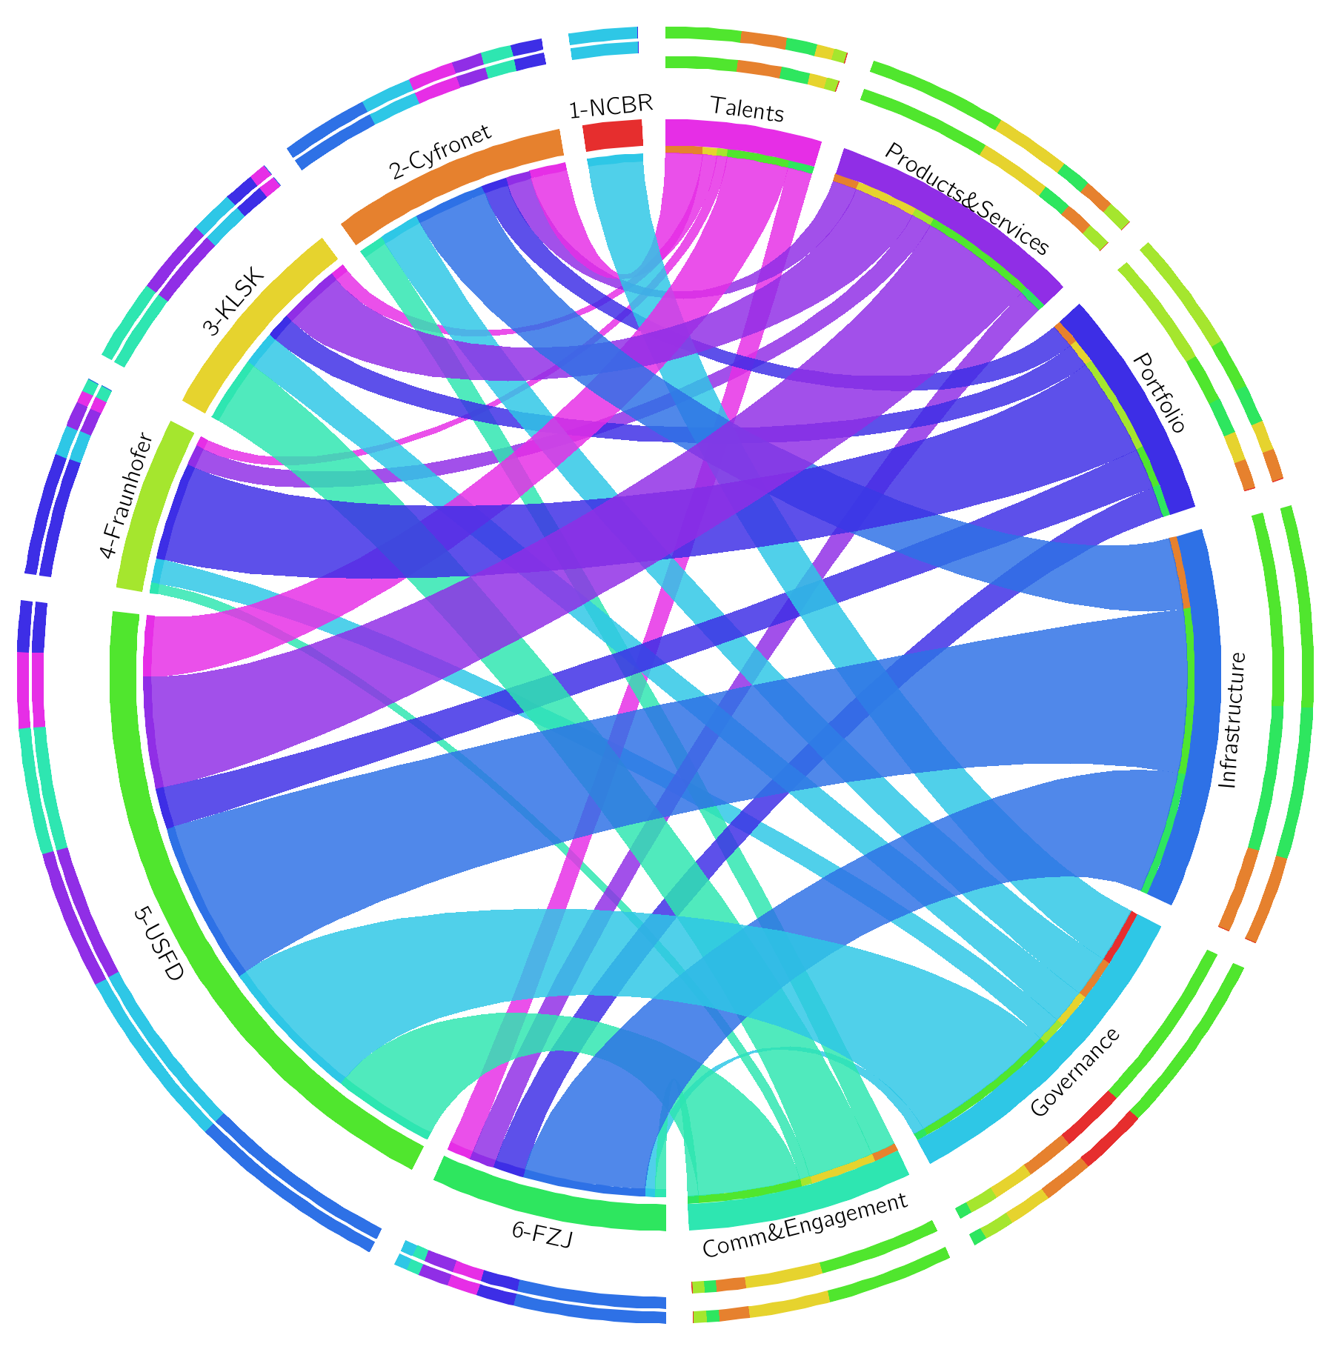
EU Teaming Project
Timeframe: 01.08.2019 – 31.07.2026
Funding: 15 MEUR in total; close to 9 M EUR for Sano
Consortium – 5 regular partners and 2 linked third parties
Sano – Consortium Leader
University of Sheffield and Sheffield Teaching Hospitals Trust (LTP)
Forschungszentrum Jülich and University of Aachen (LTP)
Fraunhofer Institute for Systems and Innovation Research ISI
AGH University of Science and Technology, ACC Cyfronet AGH
Klaster LifeScience Kraków
Teaming project’s role:
Building capacity and enabling Sano in carrying out cutting-edge research projects in the domain of computational medicine

Slide 6
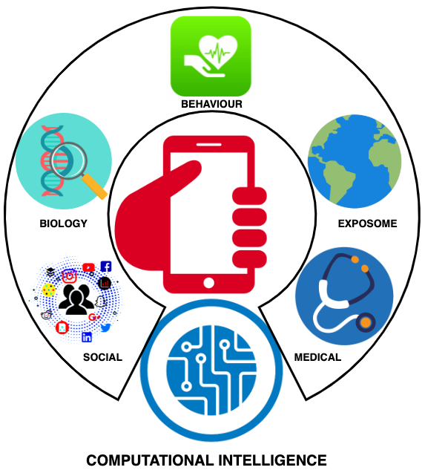
Personal Health Data Science Group
The group has a research vision of “Citizen-Before-Patient” (CB4P). To develop it, the focus it’s on the mission of “Empowering personal health decision making with actionable insights from a Computational Intelligence Architecture of Choice”.
Dr Jose Sousa, Honorary Lecturer at Queen’s University Belfast
Team Leader At Sano from 1. November 2021
PhD students: (2)
Kamil Woźniak
Maria
Post-docs: (3)
Anna Drożdż
Alfredo Ibias
Karol Piotr Capala
(expected to start at the beginning of September, 2022)
Scientific Programmer:
Varum Varma

Slide 7











Personal Health Data Science Group
Publications: 2 accepted, 1 submitted:
Sousa, J., Barata, J., Woerden, H. C. van & Kee, F. “COVID-19 Symptoms app analysis to foresee healthcare impacts: Evidence from Northern Ireland”. Applied Soft Computing, 116, 108324–108324, 2022, https://doi.org/10.1016/j.asoc.2021.108324 (IF: 6.72)
Bontempi, G. et al., “The CLAIRE COVID-19 initiative: approach, experiences and recommendations”, Ethics and Information Technology, 2021, https://doi.org/10.1007/s10676-020-09567-7. (IF: 1.5)
Barata J, Mendes M, Santos APM, Neves MJM, Wozniak K, Drozdz A, Sousa J. “Artificial Intelligence-Enabled Medicine Dispensing: From Concepts to Practice in the Community Pharmacy”, JMIR Preprints. 31/03/2022:38426 (https://preprints.jmir.org/preprint/38426). (IF: 5.43)
Conferences: 2 accepted in the VPH 2022 CONFERENCE on VIRTUAL PHYSIOLOGICAL HUMAN - Digital twins for personalized treatment development and clinical trials
Grant applications: 3
Joint Transnational Call 2022 ERA PerMed - 2GETHER(ERAPERMED2022-137) From behaviour about health and science to vaccination what can machine learning evidence help to prospect (not funded)
Excellence Hubs - HORIZON-WIDERA-2022-ACCESS-04-01 – PROSPECTAI (being assessed)
HORIZON-HLTH-2022-IND-13-02 — Scaling up multi-party computation, data anonymisation techniques, and synthetic data generation – PLASTICITY - ARTIFICIAL INTELLIGENCE 4 TRANSNATIONAL PERSONALISED HEALTH - Lead by Sano (being assessed)

Slide 8
DEVELOPING A SELF-SUPERVISED COMPUTATIONAL INTELLIGENCE
WHY IS IT RELEVANT?

Slide 9

SUPERVISED AND UNSUPERVISED MACHINE LEARNING
TWO FACES OF THE SAME BIG DATA COIN

Slide 10
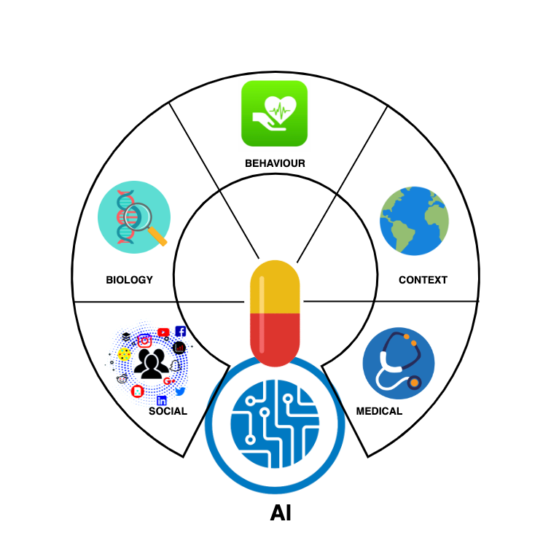
Supervise and Unsupervised Learning
In Personal health environments the type of data captured will vary widely from sensors, environment, health care records, images, videos, social media, text etc. creating a multiverse of data.
Machine Learning has provided much value for health care, but there are three key main constraints limiting its full potential:
Data Driven
Silos
Significant Human Input

Slide 11
Architecture of Choice

Slide 12
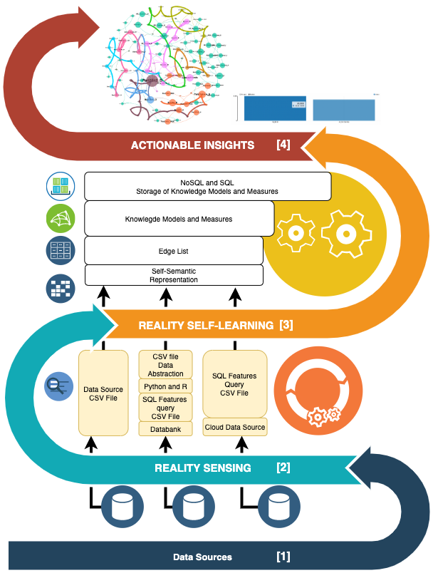
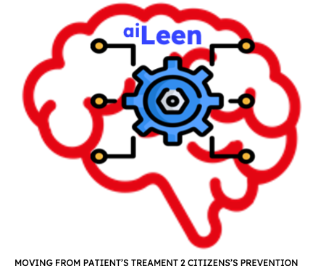
Self-Supervised Computational Intelligence Learning
Abstractions
Integration
Self-Learning

Slide 13
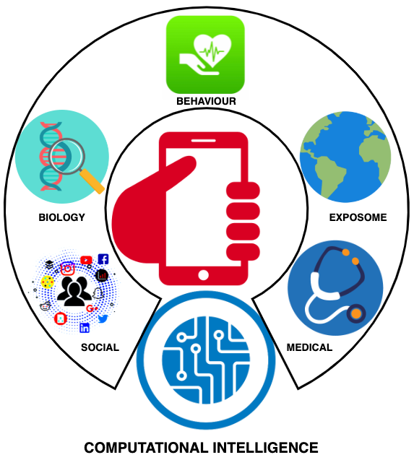
Research focus: CITIZEN BEFORE PATIENT
Empowering personal health decision making with actionable insights from a Computational Intelligence Architecture of Choice
While most individuals are now constantly “online”, consuming and providing enormous amounts of information, healthcare deliverables remain relatively unchanged compared to thirty years ago.
With a long-term goal to co-create a personal health architecture of choice that will collect available information about individuals and provide model based evidence on personal health.
By integrating medical records, genetics, microbiome genetics, behavioural information (exercise level, sleep quality, physical activity, etc.), stress levels, dietary habits, food quality, environmental factors (e.g. pollution, allergen levels) and other socioeconomic factors build a multiverse machine self-learning processes.
Building upon Poland’s unique position as a single-payer healthcare system with centralized access to data concerning a vast number of patients.
Co-developing with medical institutions access to detailed medical data (EHR, imaging and multi-omics).
We aim to deliver AI machine self-learning models for improving the health of entire populations.

Slide 14
The journey so far…
AMD (Age-related Macular Degeneration)
Diabetes and Diet
Dementia
COVID-19

Slide 15
Testing Challenges
Healthcare field reliability
GDPR compliant
AI verification
Etc…

Slide 16
Testing Challenges
Working in the healthcare field requires of extra reliability:
We are working with human lives.
We are working with people’s data.
An error could lead to wrong diagnostics.
Etc…
All the components require a strict testing to
ensure the required quality:
Reliability measures.
Testing of critical systems.

Slide 17
Testing Challenges
The required GDPR compliance introduces more challenges:
Secure data management.
Limited access to deployment machines.
Etc…
This requires of a correct assessment of
the tool’s security:
Information flow measurement.
Data leakages detection.
Testing of safe heavens.
Testing of containers.

Slide 18
Testing Challenges
The developed AI methods pose further challenges:
Why they produce a decision?
A 100% accuracy is not viable.
Etc…
This requires of a proper analysis of the AI tools:
Decisions explainability.
AI error detection.
Testing of AI models.

Slide 19
Testing Challenges
Getting back to our architecture:
Automatic detection of anomalies
on the data.
Testing of distributed databases,
involving safe heavens.
Validation of resulting models.
Testing of mobile app's.

Slide 20
Testing Challenges
The end product: A mobile app for personalized healthcare.
It should be GDPR compliant.
It should run ML models on the edge.
It should communicate with a de-centralized
self-supervised learning infrastructure.
Additional testing challenges:
Testing of communication protocols
(specially with safe heavens).
Testing of data aggregation algorithms.
User input validation and error detection.
Etc…

Slide 21


Centre for Computational Medicine www.sano.science
We are
Hiring!
Alfredo Ibias
PERSONAL HEALTH DATA SCIENCE (PHDS)
Postdoctoral Researcher @ Sano
a.ibias@sanoscience.org

